Slide 1


AtliQ Hardware
Business Model
Sumit Mahato

Slide 2

AtliQ Overview
C
Atliq Hardwares, a global supplier of computer hardware and components like PC, Mouse, Printer,Keyboards etc.

Slide 3
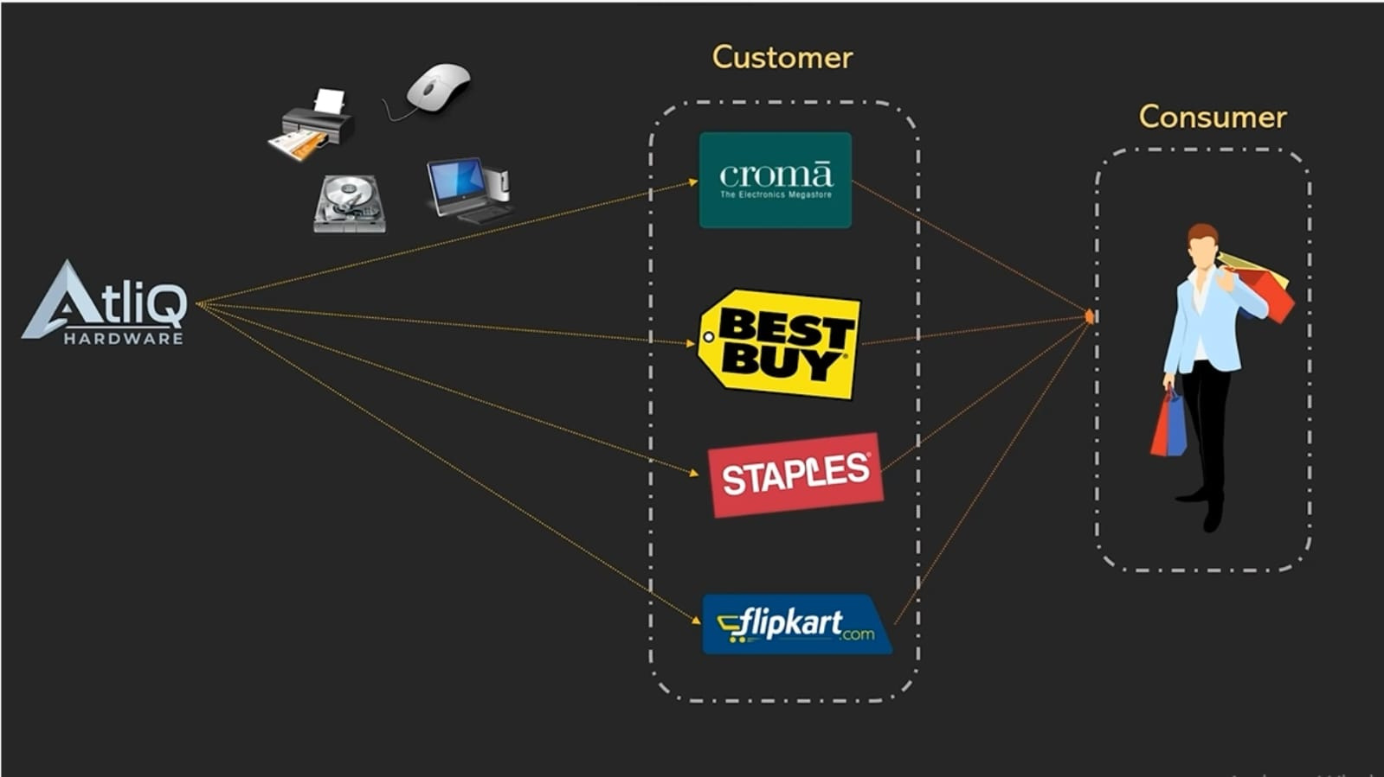
AtliQ Customer
C

Slide 4
Customer
Customer And Consumer
Customers are stores like Amazon, Croma, Flipkart
Consumer
Consumer means the end users who purchase and use the products.

Slide 5
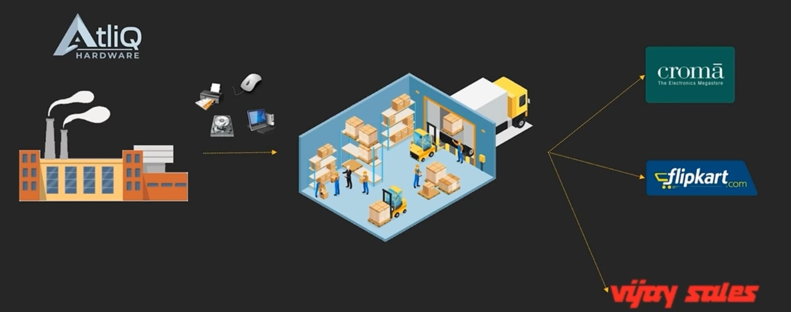
AtliQ Industry
C

Slide 6
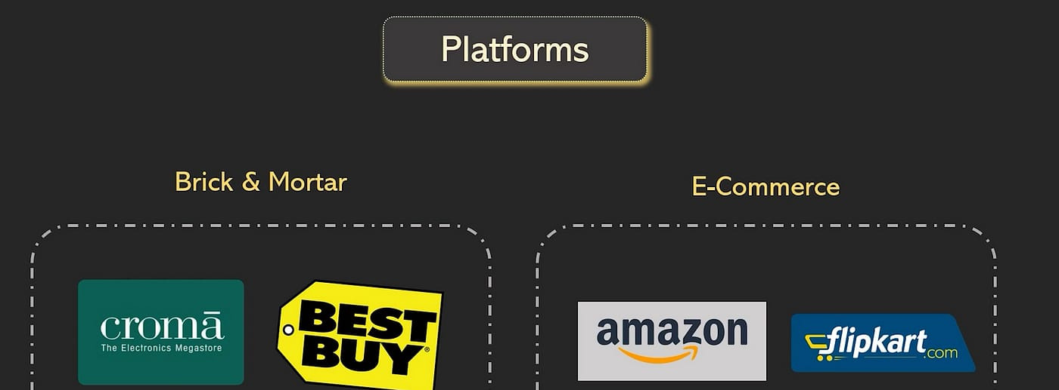
AtliQ Platforms
C

Slide 7
Platforms
AtliQ operates through two primary mediums where product interactions and sales take place: platforms.
Brick & Mortar
E-Commerce
Physical retail stores where customers can see and touch products in person, such as Croma and Best Buy.
Online marketplaces where products are sold through digital platforms, including Amazon and Flipkart.

Slide 8
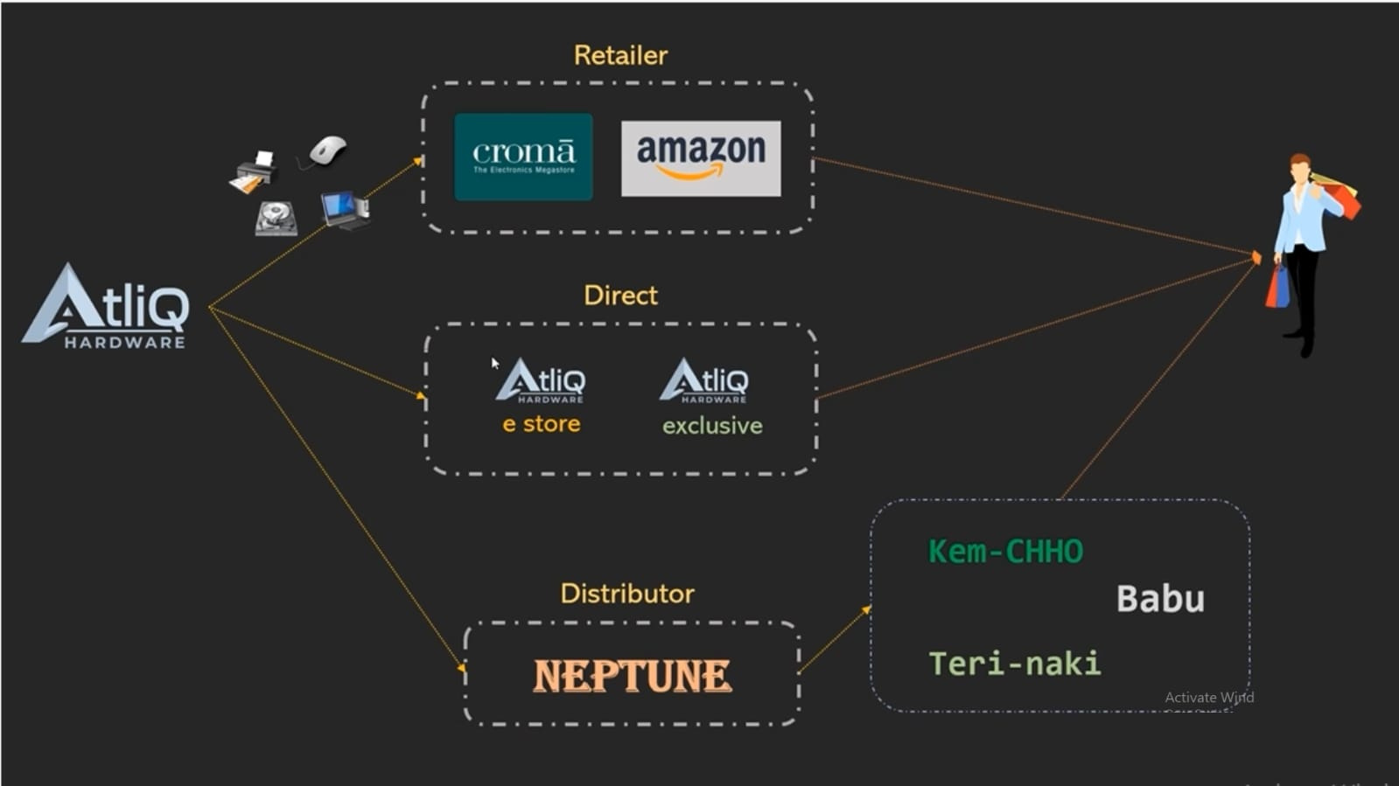
AtliQ Channels
C

Slide 9
Channels
AtliQ sells its products through three main channels
Retailer
Products are sold via e-commerce websites or physical stores to end consumers.
Examples include Flipkart and Best Buy.
Direct
Products are sold directly to consumers through AtliQ’s own stores or online platforms,
such as AtliQ E-Store and AtliQ Exclusive.
Distributor
Products are sold to large distributors in regions where direct sales are restricted.
These distributors then supply local stores. An example is Neptune.

Slide 10
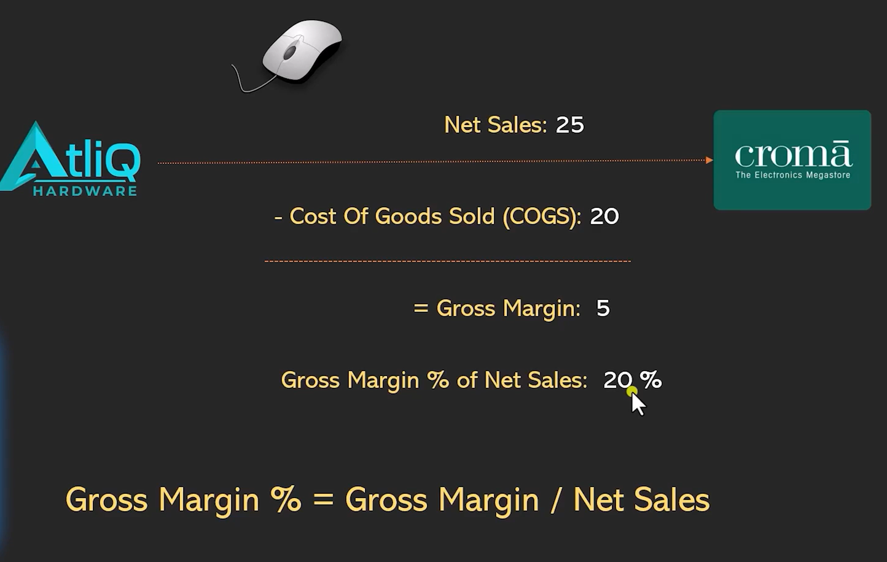
AtliQ Finance
C

Slide 11
Finance
Net Sales: Total revenue from sales after deducting returns, allowances, and discounts.
COGS (Cost of Goods Sold): Direct costs of producing goods, including materials and labor.
Gross Margin: Net Sales minus COGS, indicating the company's profitability before operating expenses.
Gross Margin %: Gross Margin as a percentage of Net Sales, showing the efficiency of production cost management relative to revenue.

Slide 12
Thank You

